Slide 1
TreeHug
The theoretical tree for all the theoretical friends you’d want to hug

Slide 2
Team Members
Milton Joseph - Project Manager
Justin Mazor - Database / API
Benjamin Richards - API
Jacob Waldner - API
Jason Evans - Front End
Samuel Bauta - Front End

Slide 3
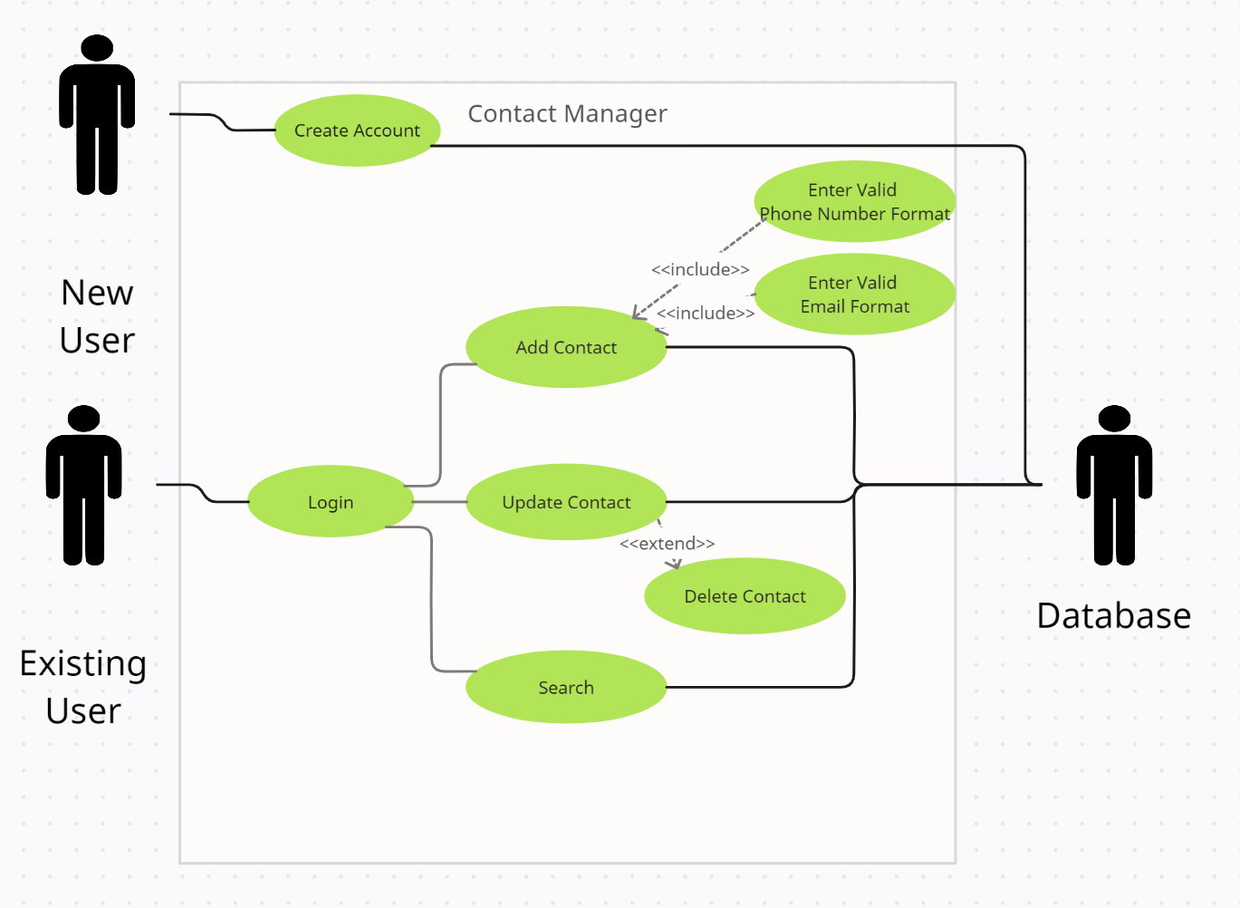
Use Case Diagram

Slide 4
Project Manager
Created Gantt chart
Kept track of progress / timeline
Created use case diagram
Created this powerpoint
Ensured team was equipped for success

Slide 5
Database
Created database using mySQL
Collaborate with front and back end to ensure database was responding appropriately to commands

Slide 6
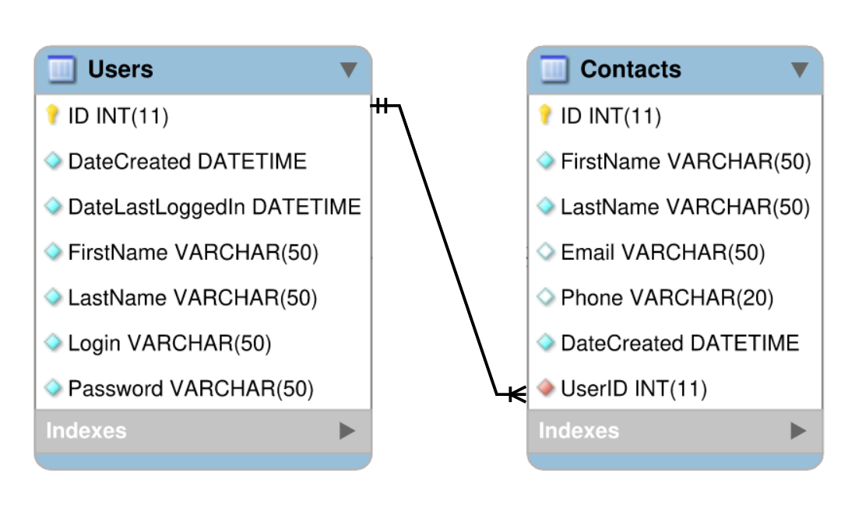
Entity Relationship Diagram

Slide 7
API
Created API endpoints using php
Ensure functionality of endpoints using Swaggerhub

Slide 8
Front End
Creating responsive web page
utilize css
connect to API using Javascript
Design page layouts
Data entry validation

Slide 9
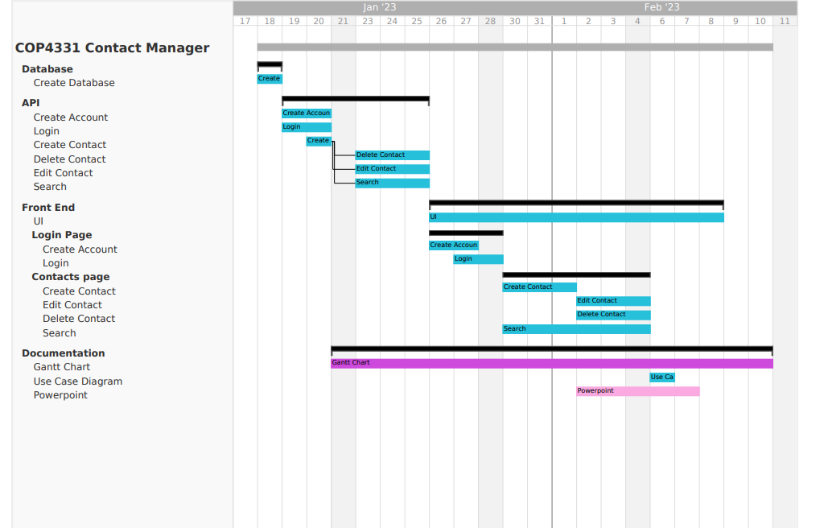
Documentation – Gantt Chart

Slide 10












Technologies Used
Digital Ocean – Hosting IP
LAMP Stack – Linux, Apache, MySQL, PHP
GoDaddy – Domain Name
Javascript
JSON
Swaggerhub
SSH
GitHub
Discord
GanttPro
Creately
Bootstrap
PHP

Slide 11
Things that went well
Excellent communication & team dynamics
Team members overlapped responsibilities
Prior database knowledge
Prior experience with SSH and Linux

Slide 12
Things that did not go well
Front end development proved to be more complex than initially thought to be.
Issue with contact table not populating
Database crashing
Running out of RAM
Issues with GanttPro trial usage

Slide 13
Demonstration
Swaggerhub Link

Slide 14
Demonstration
Website Link

Slide 15
Questions

